Slide 1
Analyzing the Effect of Reddit Discussions on Stock Performance

Slide 2
Problem Definition
Reddit is a social media platform where users can share, discuss and communicate about wide range of topics including investing and finance. This platform can have a significant impact on stock prices. It can provide valuable information and help them to identify the values of the stocks to the investors. The problem at hand is to conduct an analysis into how Reddit discussions effect the stock performance of publicly traded companies.
In recent years, Reddit gained attention for its role in influencing the stock market. For example, in January 2021, retail investors coordinated on Reddit to drive up the price of Gamestop shares, causing significant losses to the stocks that bet against them.

Slide 3
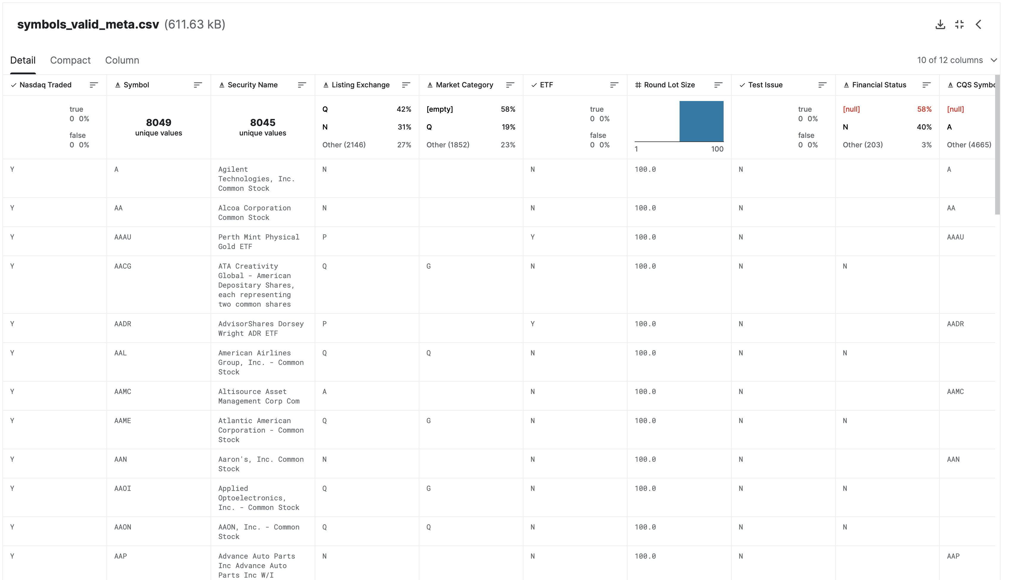
Data Description
This dataset is taken from kaggle.
This represents the stock market.
We need to compare these datasets.
We have 2 datasets
Other one called wallstreetbets community posts and mentions dataset.

Slide 4
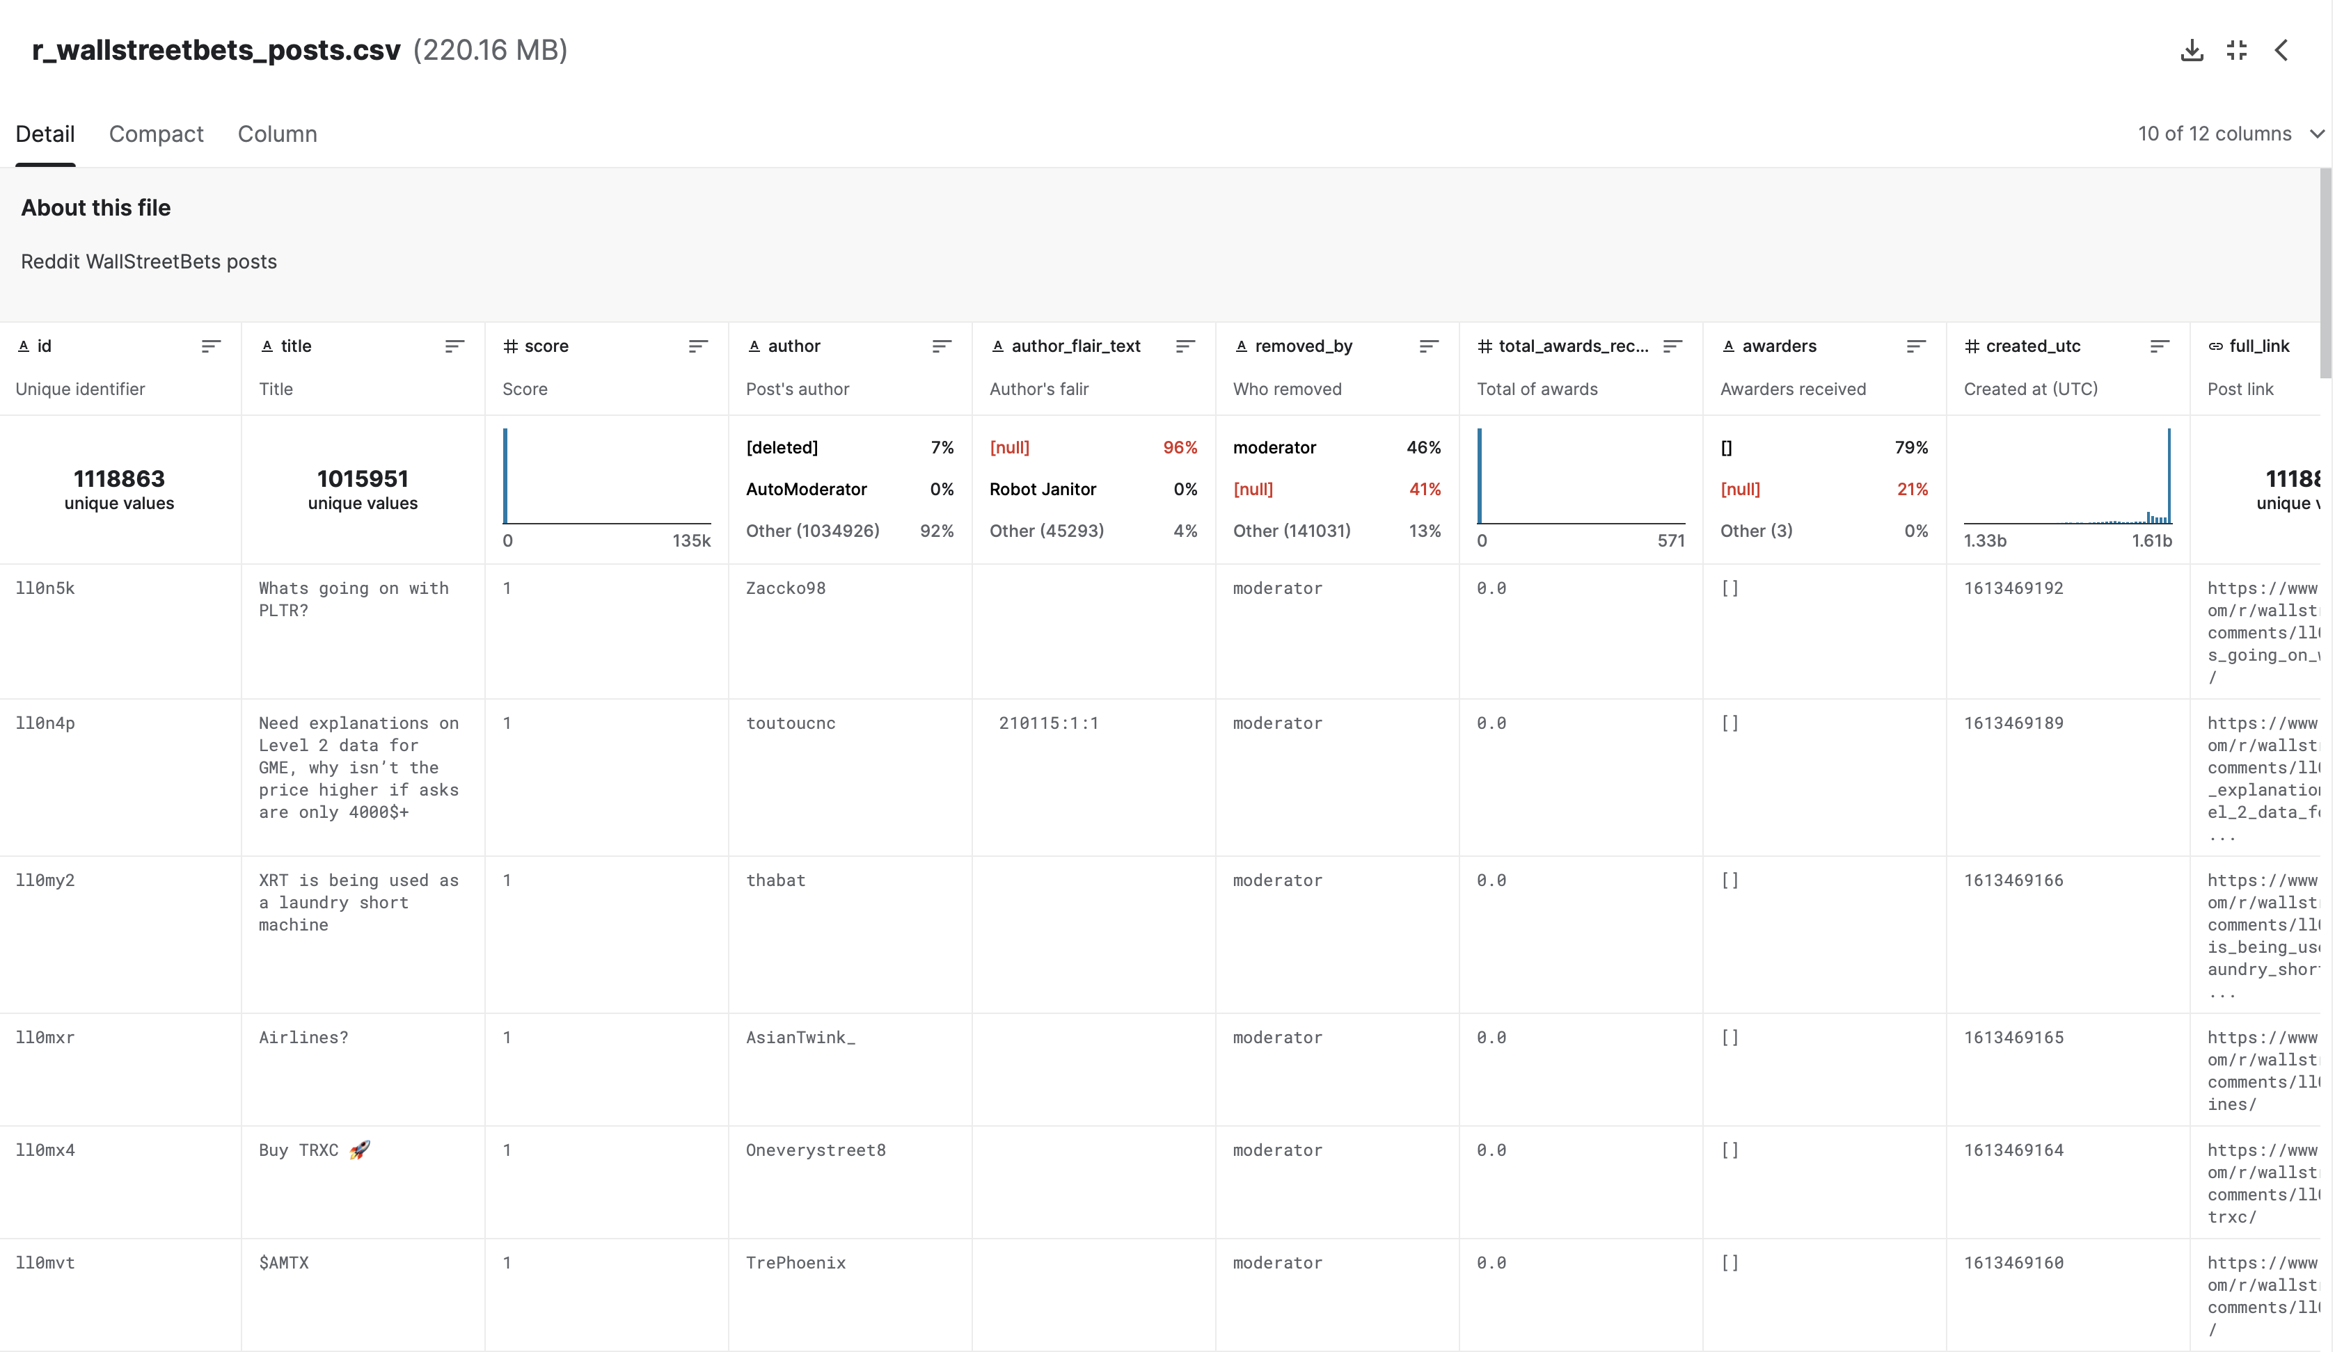
Data Description

Slide 5
Data Description
Dataset Links
https://www.kaggle.com/datasets/jacksoncrow/stock-market-dataset/data
https://www.kaggle.com/datasets/unanimad/reddit-rwallstreetbets

Slide 6
Final Results
Data Preprocessing
The data of wallstreetbets and stock data we have generated to the latest dates.
As previously indicated, in order to obtain a data set that is accurate for the GME (GameStop) stock, we changed the time stamp from 2020 to the present.
Considering the January 2021 GameStop stock, which was extracted independently from the primary stock market data.

Slide 7
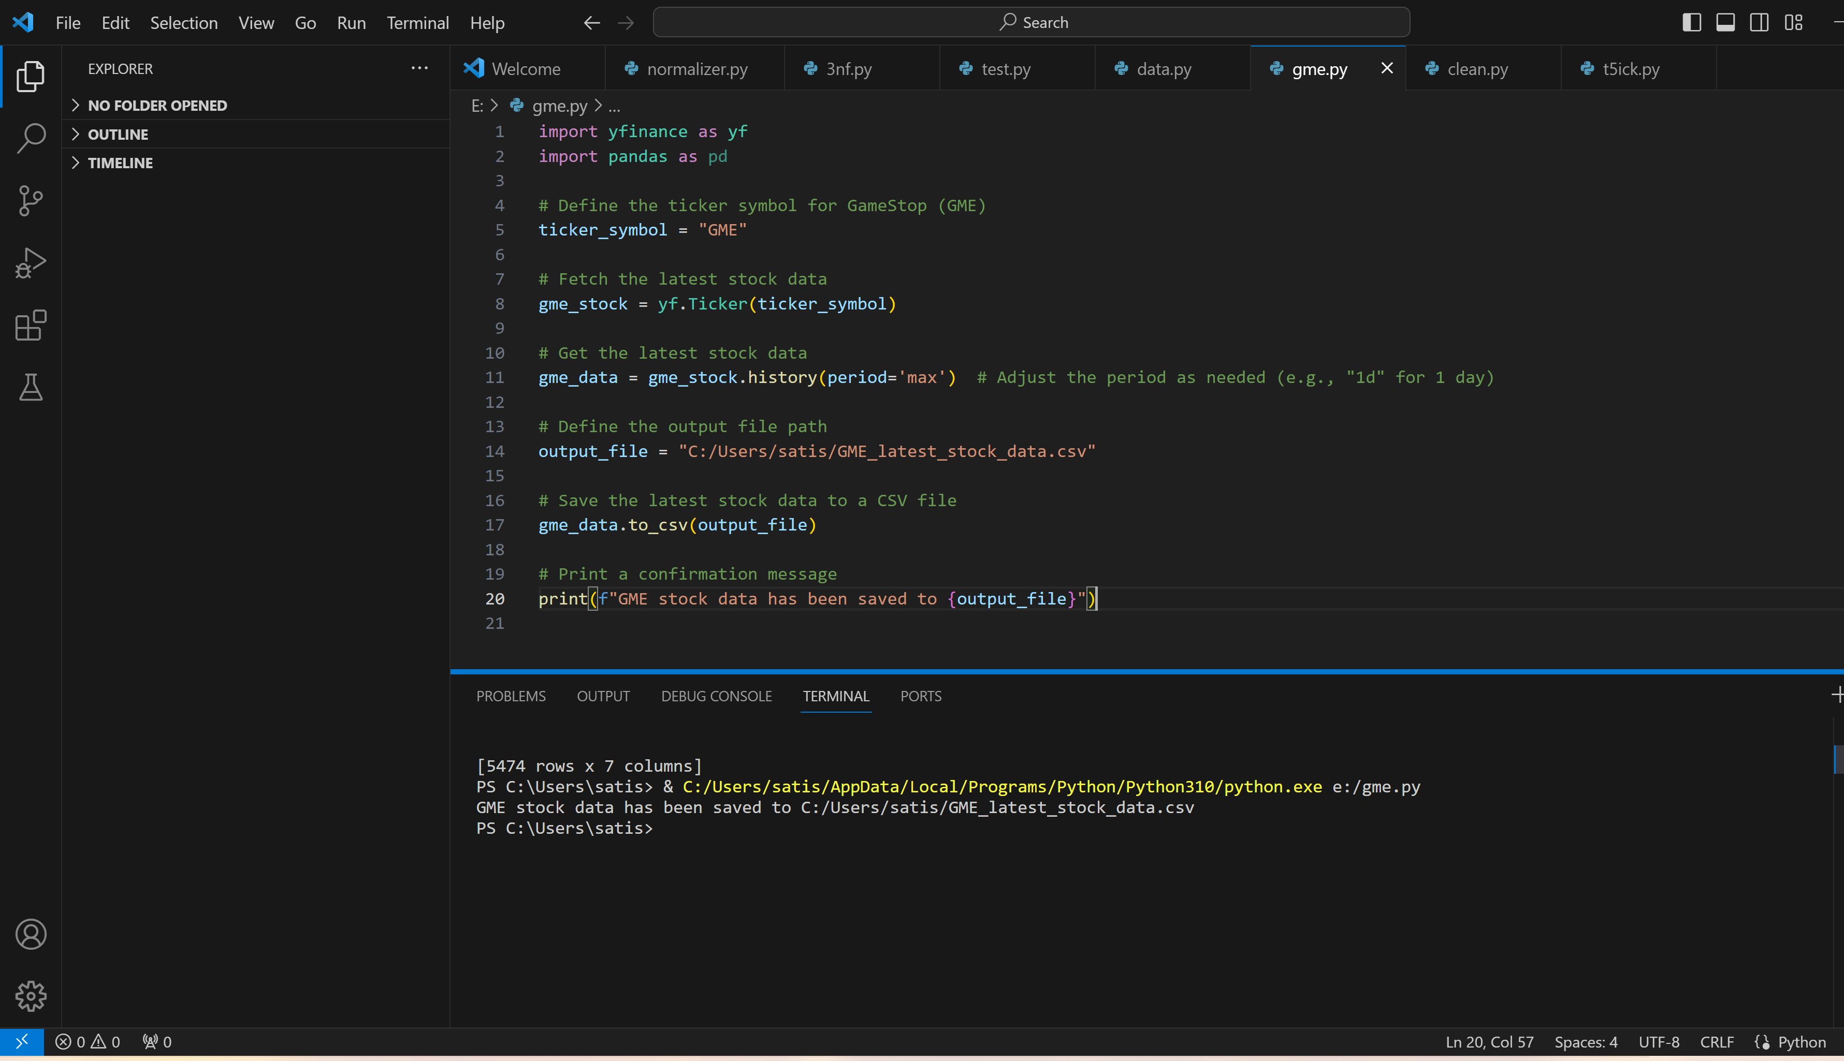
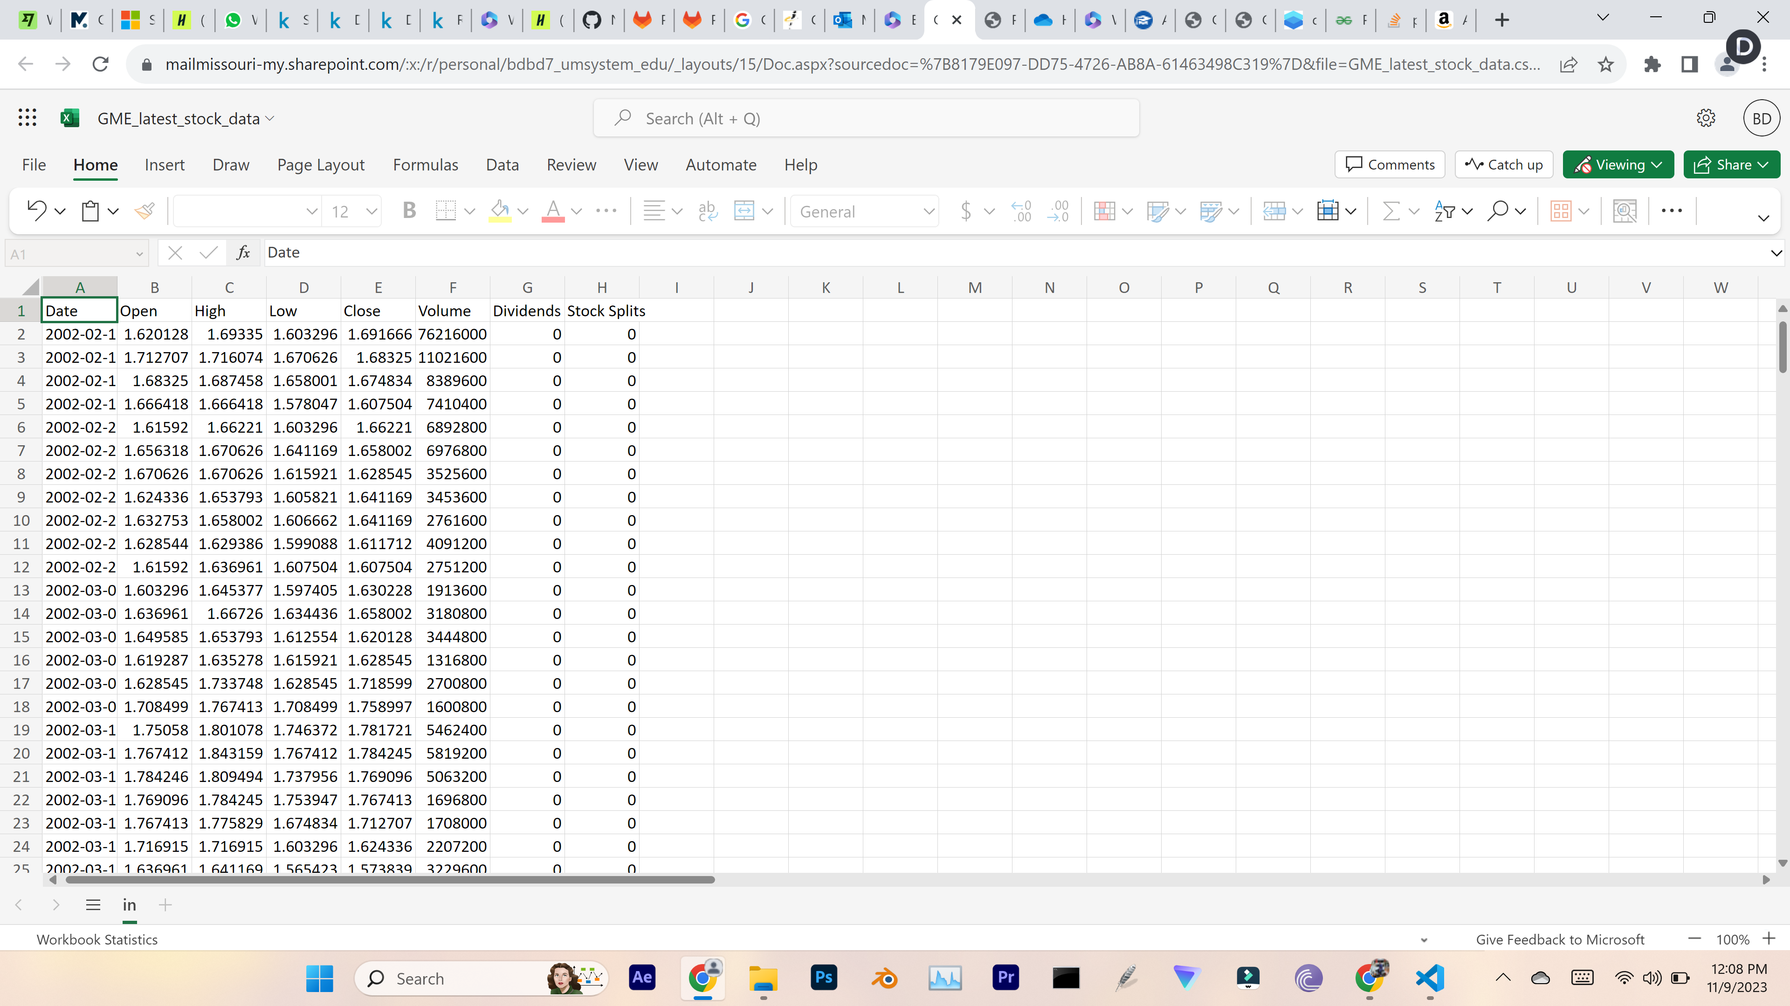
Results

Slide 8
Results
Data Processing
The data appears in a CSV format with parameters like the date and the names of the stocks.
Similarly, we have taken extracted the data of the posts of wallstreetbets and stock data of each ticker for the timeline of GME which is 2021-Jan.
Used Pandas to generate the data required to timeline

Slide 9
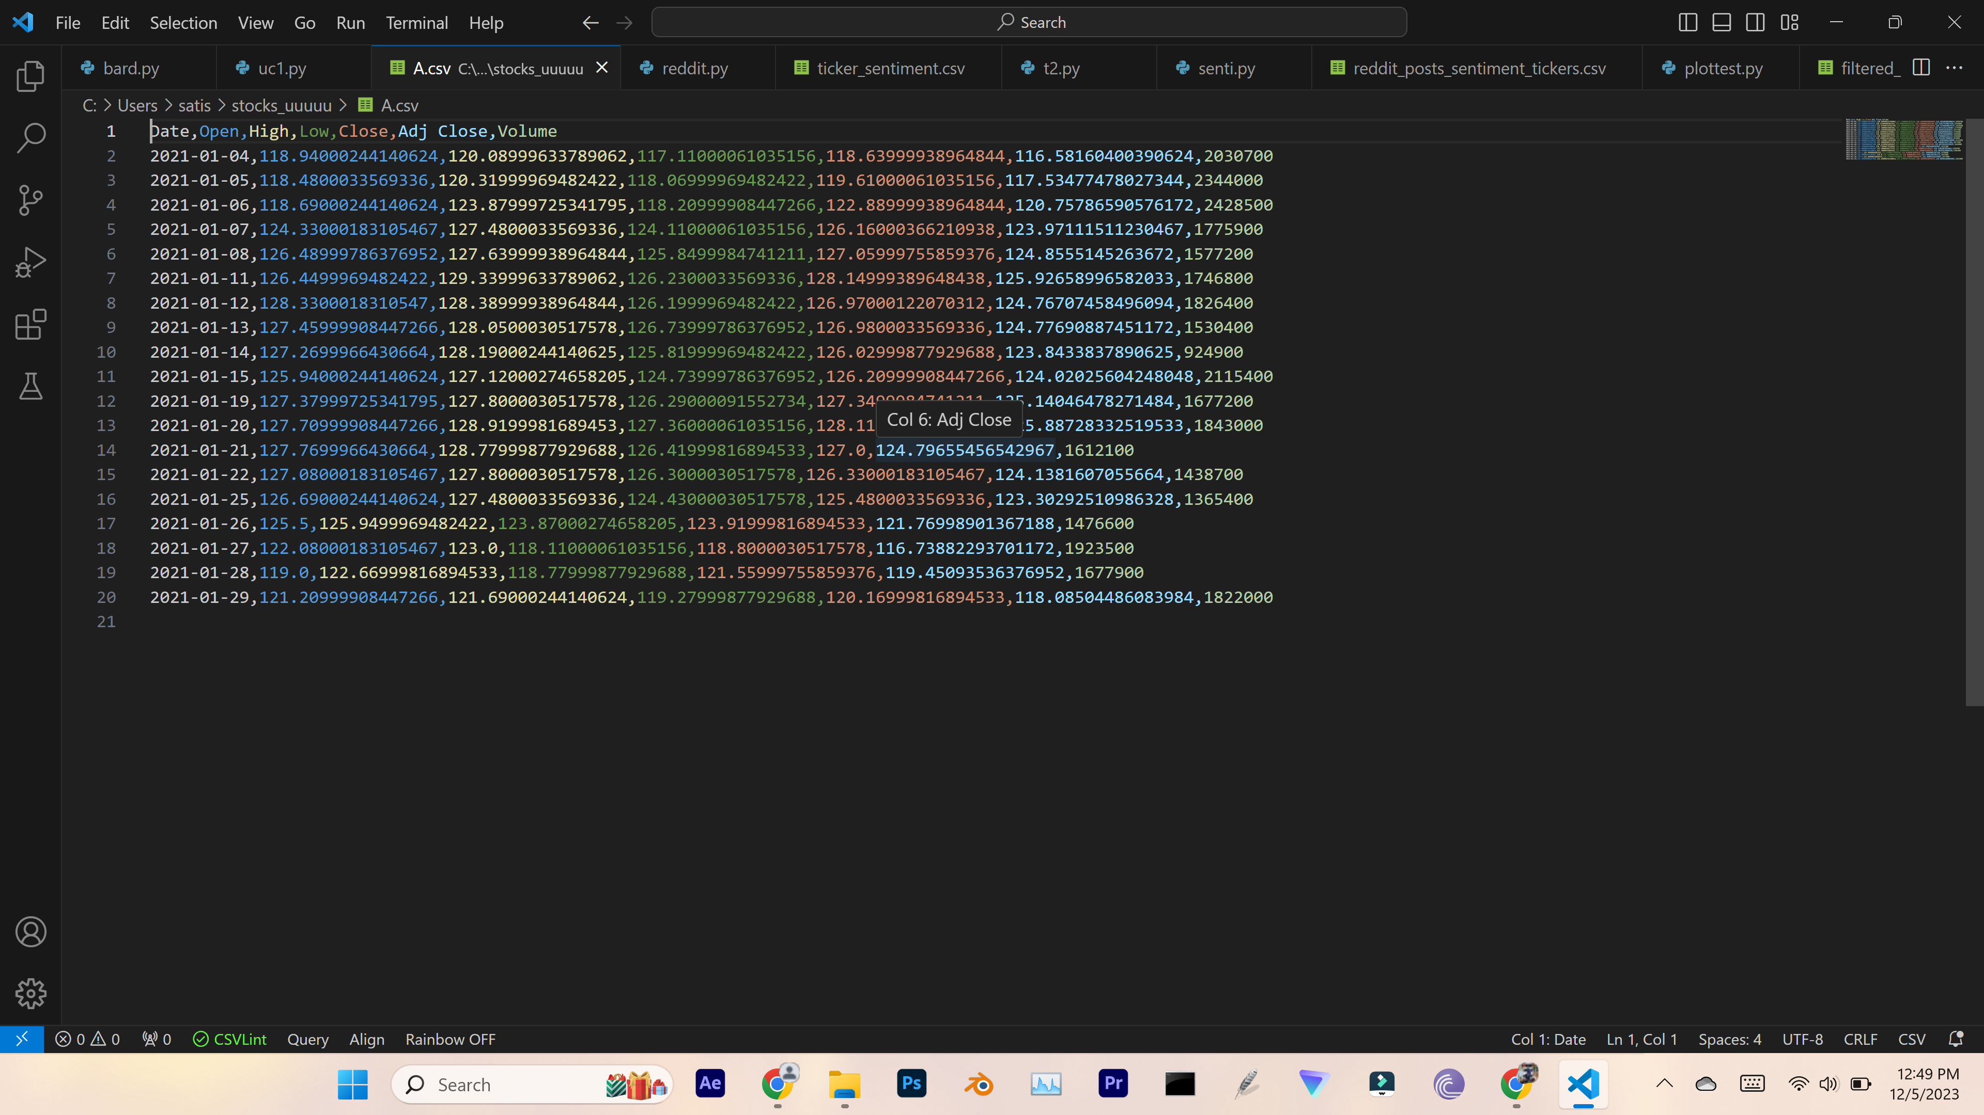
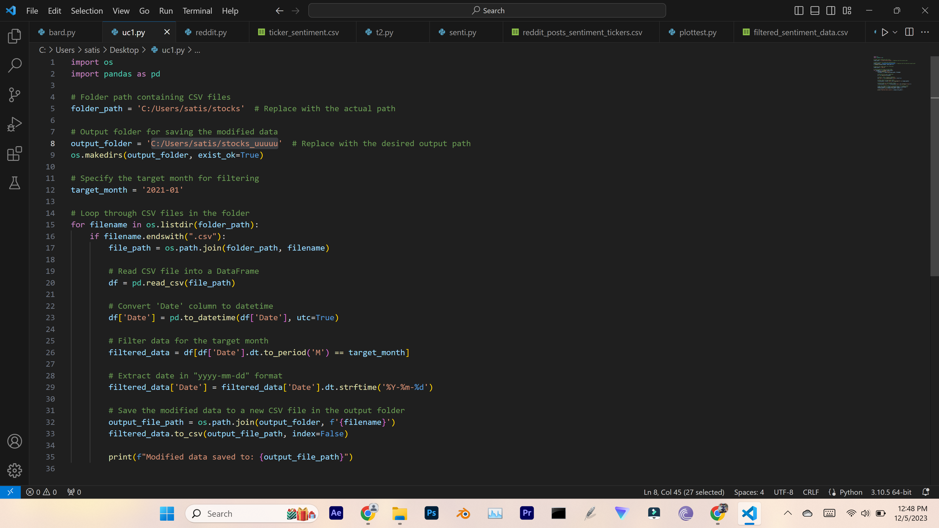
Results

Slide 10
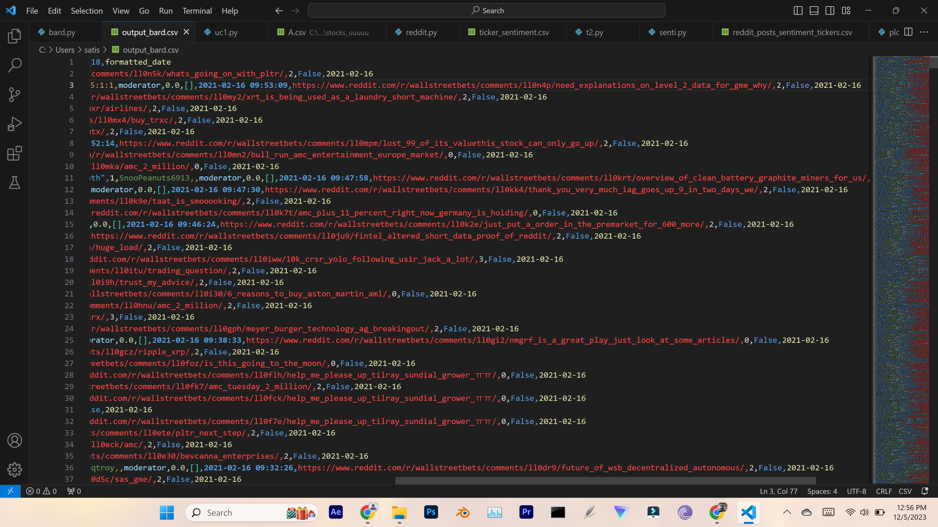
Results
Data Processing
The Data present in the wallstreetbets have the different timestamp, as result of stock data timestamp. We have transformed the time to same as stock market data which is yyyy-mm-dd.
Used Pandas library and generated required to timestamp.

Slide 11
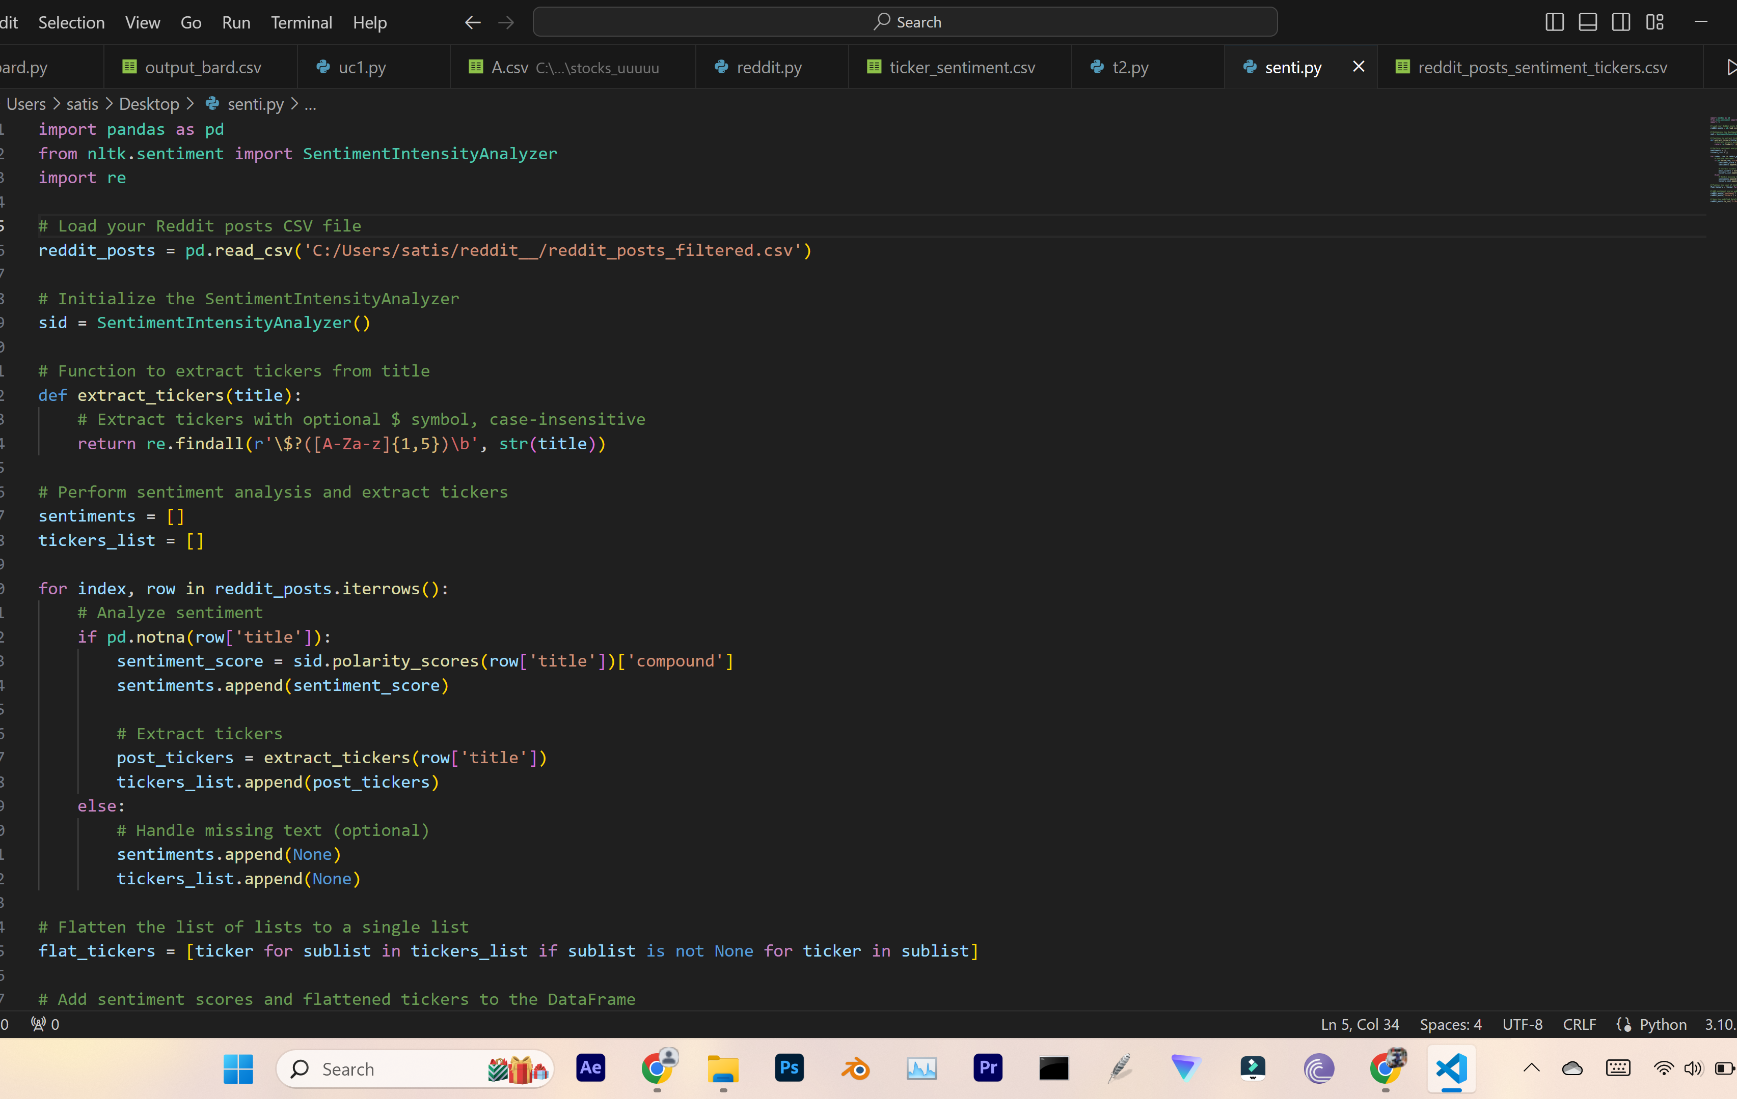
Results
From NLTK we have imported SentimentIntensityAnalyzer
It's a rule-based model that assigns sentiment scores to words and phrases based on their semantic orientation as either positive or negative. SIA also considers capitalization, booster words (e.g., "very," "extremely"), and punctuation to adjust the intensity of the sentiment scores.

Slide 12
Results
Analyzed the Reddit discussions for sentiment to see whether each stock being discussed with a good, negative, or neutral attitude.
For each chat or topic, assign a sentiment score.
Negative Scores (-1.0 to -0.5)
Weak Negative Scores (-0.5 to -0.1)
Neutral Scores (-0.1 to 0.1)
eak Positive Scores (0.1 to 0.5)
Strong Positive Scores (0.5 to 1.0)

Slide 13
Results
Addition to that we have used re (regular expressions) is a built-in module in Python that provides functionality for pattern matching and text manipulation.
re.findall: This function applies the regular expression pattern to the str(title) string and returns a list of all occurrences of the matched pattern.
We have extracted the tickers present in the posts of the reddit, by using the above module along with the sentiment score for the post where the ticker is present.

Slide 14
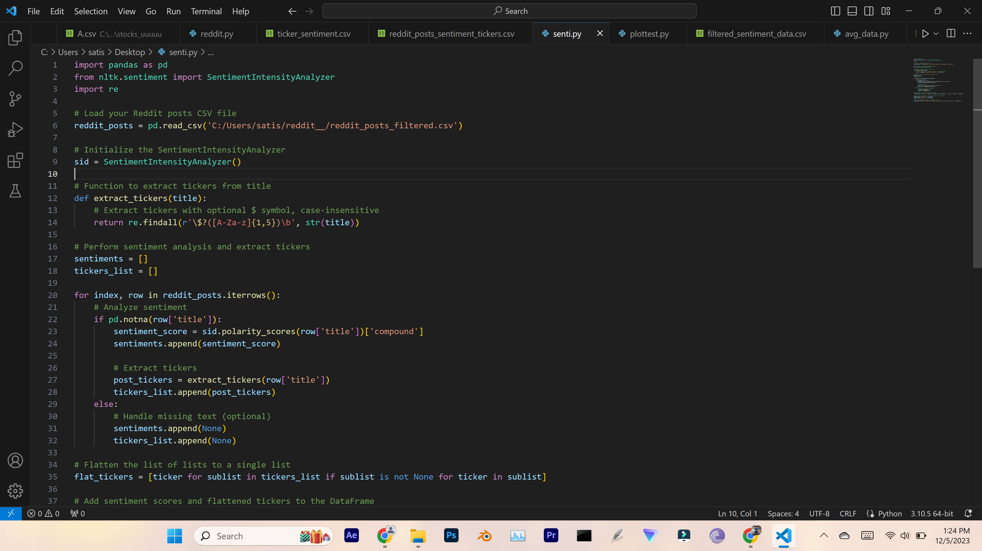
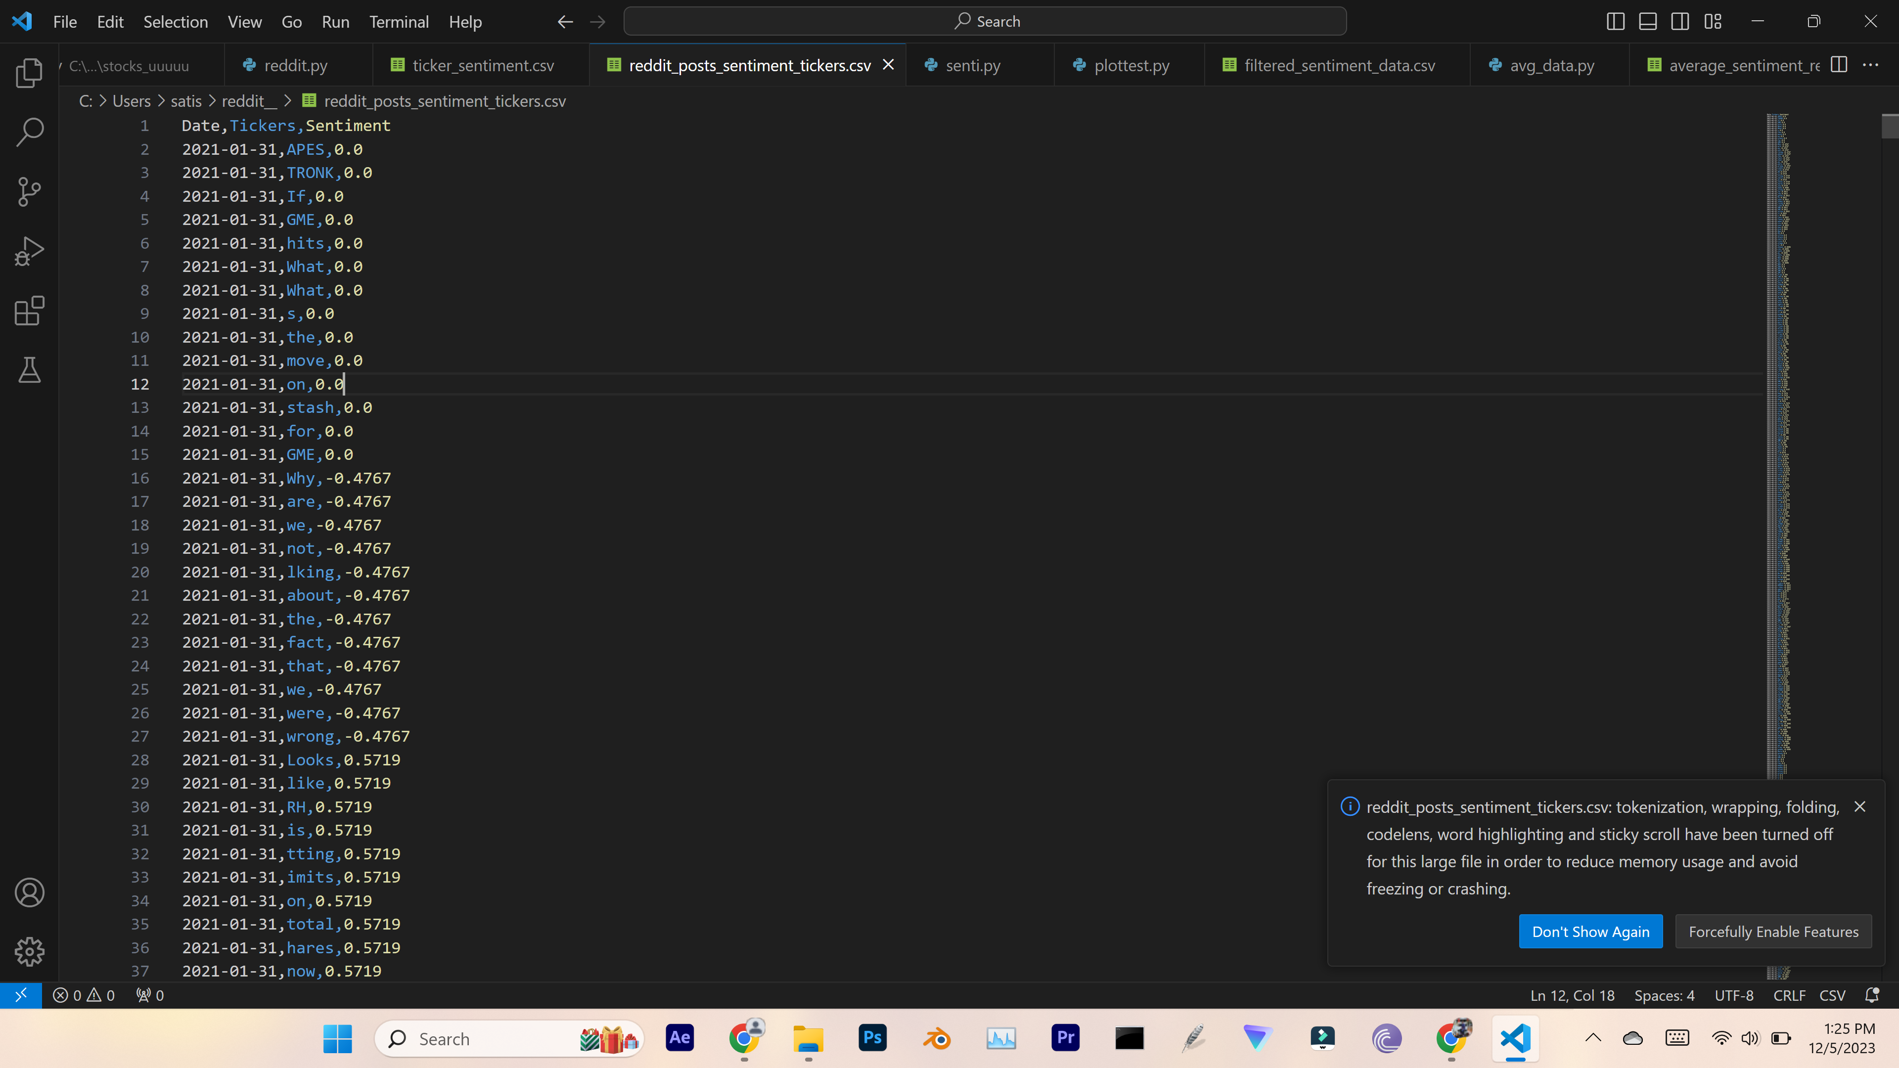
Results

Slide 15
Results
As we can see and say that after sentiment analyze and ticker extraction, some posts may have some words which contains similar formats as tickers.
The 'findall' function will extract those values also, we don’t need those values as they are not the tickers. For that we have done the comparison of the two csv files which one of them contains ticker names.
Another file generated from sentiment analyzer, we have extracted the only valid tickers and with their sentiment score along with the date of the post.
We have extracted the tickers present in the posts of the reddit, by using the above module along with the sentiment score for the post where the ticker is present.

Slide 16
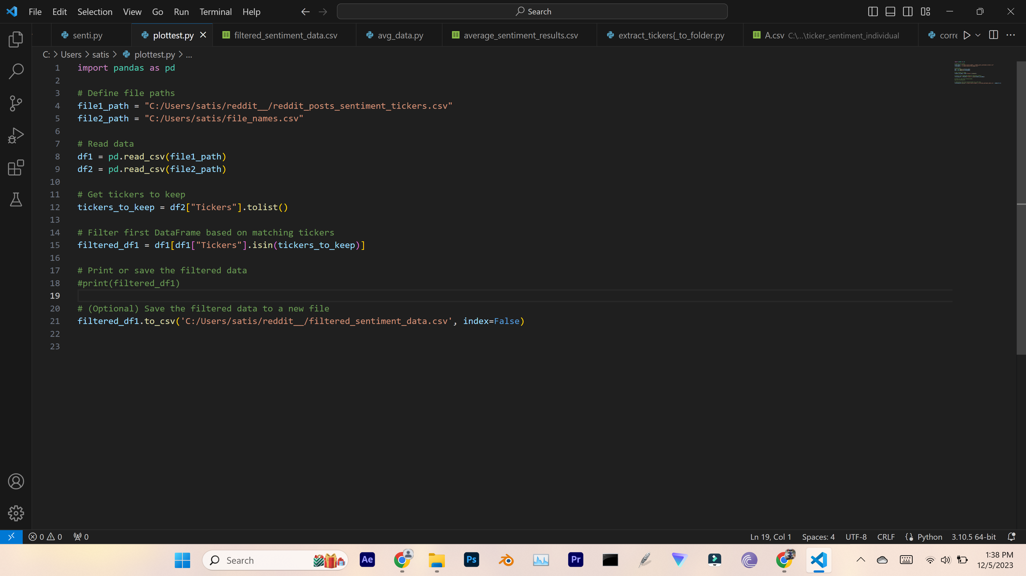
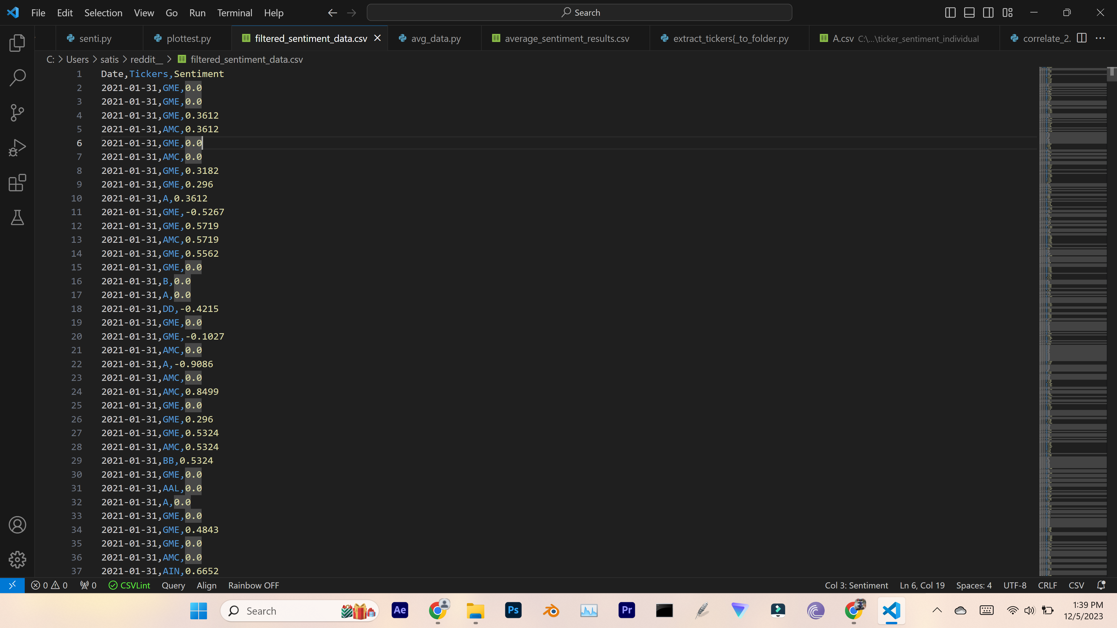
Results

Slide 17
Results
Correlation
We have correlated the both stock data and sentiment.
We have extracted the data from the file which have date,ticker name and ist sentiment score.
Correlated to the Close value in the stock data of individual ticker stock data file.

Slide 18
Results
Visualisation
Created a scatter plot to visually represent the relationship.
Scatter Plot:
Visual representation of the correlation between stock data and sentiment scores.
X-axis: 'Close' values
Y-axis: 'Sentiment' scores

Slide 19
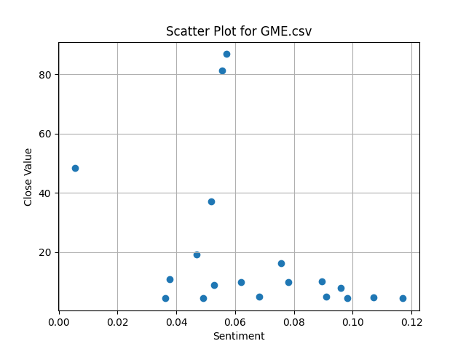
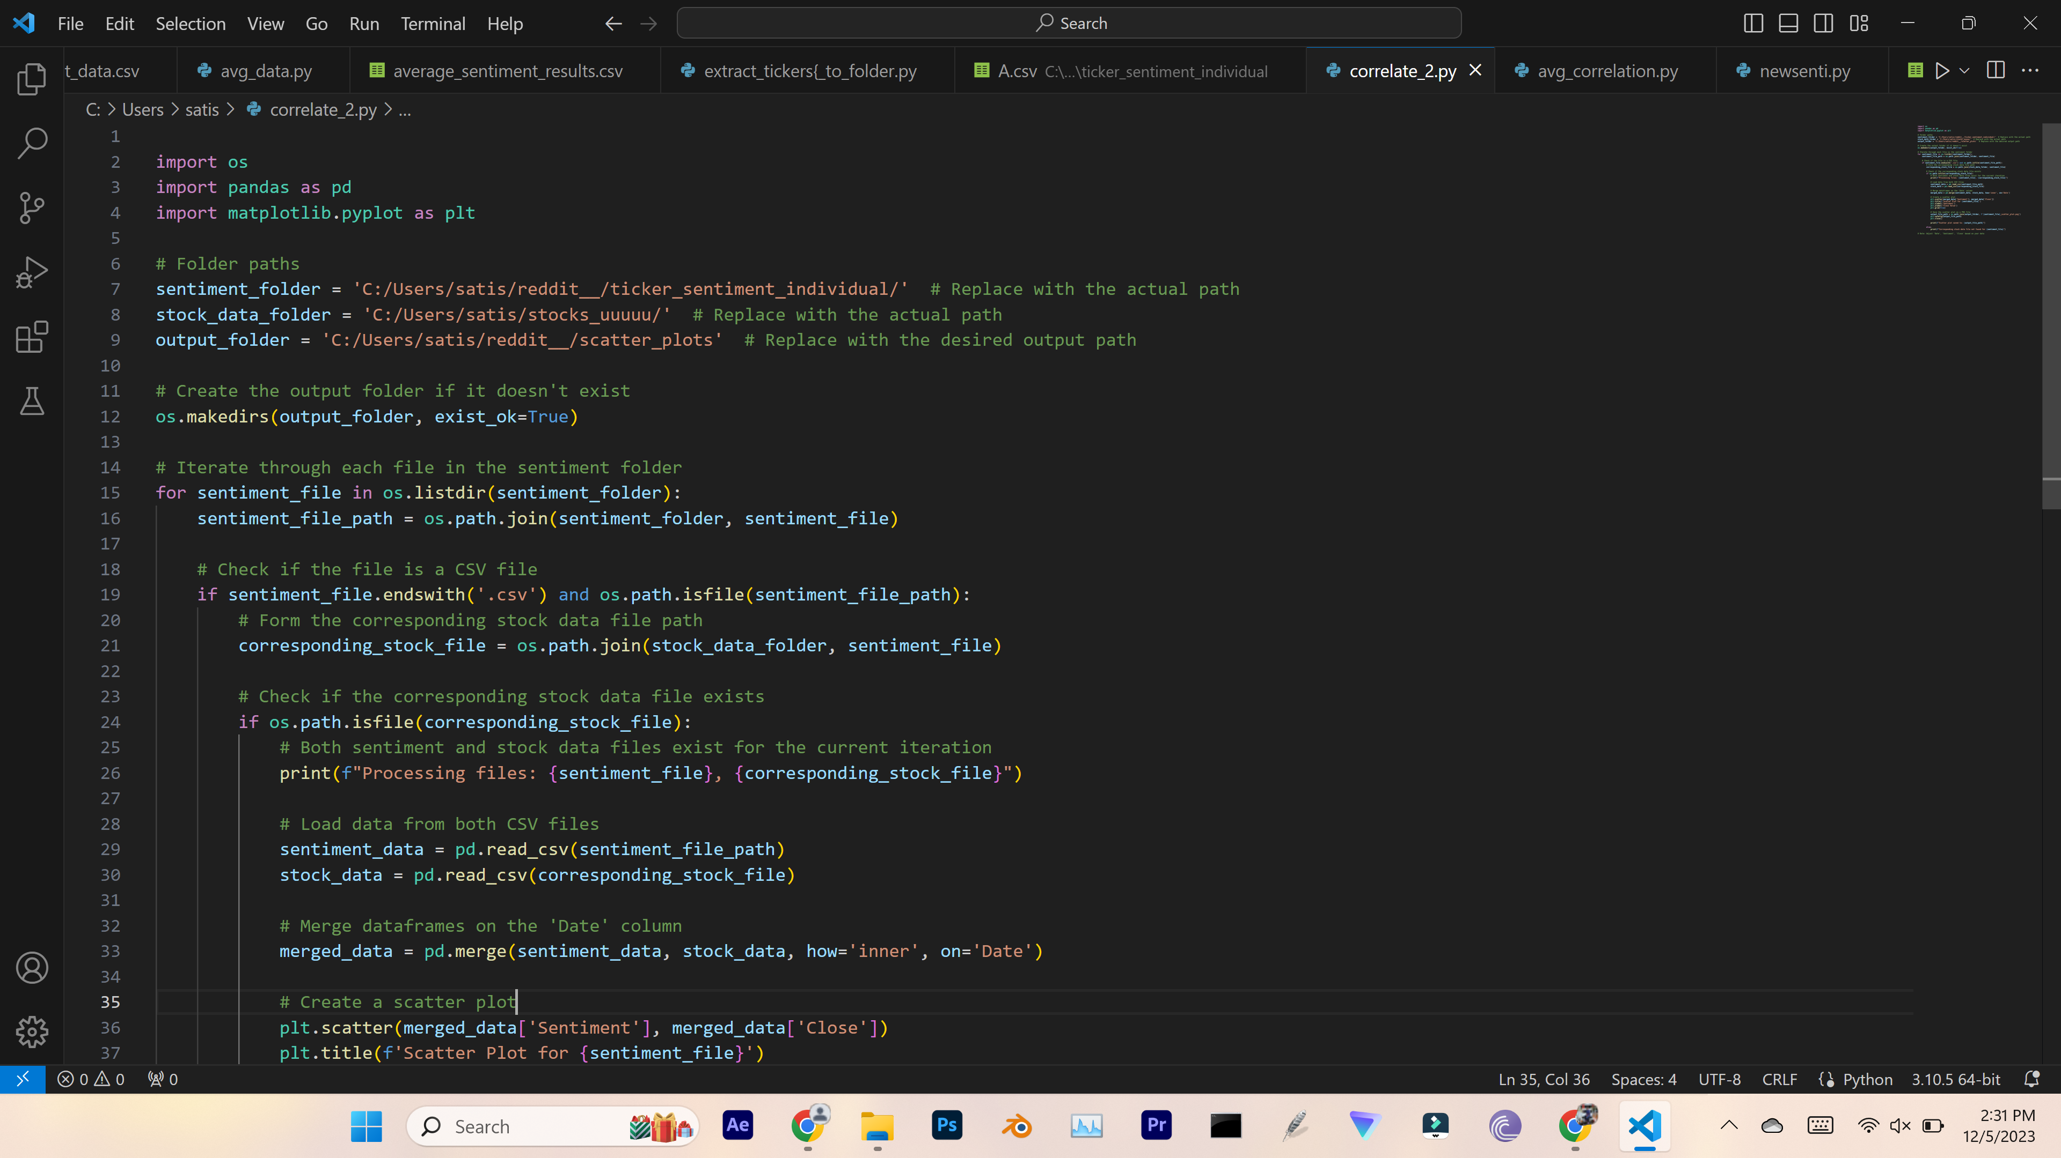
Results

Slide 20
Insights of the project
c

Slide 21
Insights of the project
Challenges faced
1) A significant portion of the data required a lot of our time to clean.
2) Converting time stamps from Reddit posts to UTC
3) Vader's sentiment analysis results did not significantly influence SIA (sensitivity intensive analyzer).
4) Since plotting the heat map was difficult to understand, we visualised the data using a scatter plot.

Slide 22
conclusion
Influence of Reddit Discussions on Stock Prices
Positive sentiment in discussions often correlates with increased buying activity, influencing stock prices to rise.
The influence appears to be more pronounced in stocks with high short interest.
Market Reaction and Regulatory Response
Traditional financial markets and institutions have experienced disruptions due to Reddit-driven stock movements.
Regulators are actively monitoring and responding to the phenomenon, contemplating potential changes in regulations to address market volatility.

Slide 23
conclusion
Things to remember
We concluded that Reddit's network is fairly large and has clear information on all topics after the project was completed.
We believe that understanding the stock market effect can be gained from the discussions of reddit posts. However, the stock market is not significantly affected by comparing a stock's value to that of the same stock on a given date.
This finding led us to conclude that Reddit posts occasionally have an impact on the stock market.

Slide 24
THANK YOU

